Slide 1
Introductory R Programming with the radsafer Package
Mark Hogue, MS, CHP
Adam Jandeska, MS, CHP
Notes:
Introduce ourselves. Warm welcome to everyone. Assurances of support. (2)

Slide 2
Motivation
Quickly access radionuclide data
Make your calculations:
easier,
faster, and
more reproducible
Fewer errors than spreadsheets, which can be treacherous
Notes:
+1 = 3

Slide 3
Course Outline
Getting started in R and Rstudio
Introduction to radsafer – overview
Families of functions in radsafer
decay corrections
radionuclides
a few miscellaneous functions
rad measurements
mcnp tools
Notes:
+1 = 4

Slide 4
What should I get out of this?
Become familiar with R
Learn at least one function in radsafer that you can use
Notes:
Nobody knows all of R and there’s no reason you should know all of any particular package.

Slide 5
What you need to get started
If you haven’t installed R yet, it’s easy to find:

Slide 6

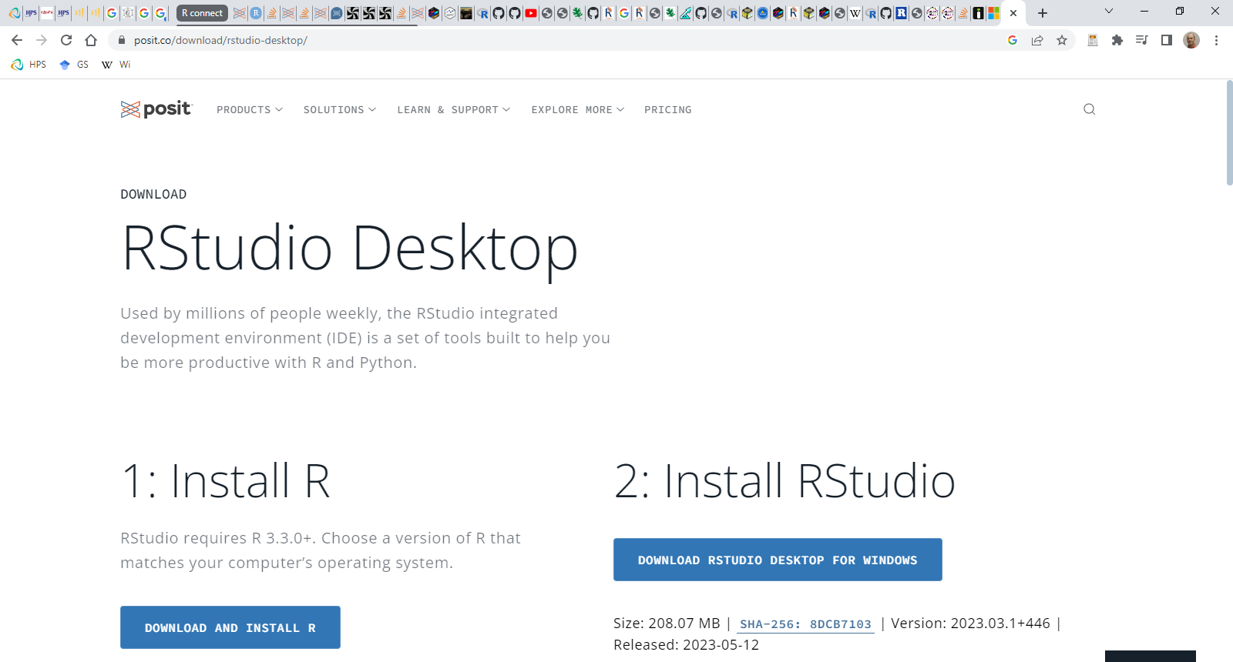

Slide 7
What you need to get started
You can run R by itself, but we’re going to use Rstudio
install.packages("radsafer")
Rstudio setup
Rstudio pane layout
Tools / Global Options
Notes:
show steps in Rstudio to install packages.

Slide 8
Getting Started Outline
Check installations / Install R and Rstudio
install.packages("radsafer")
Simple operations
Scripts
Functions in R
radsafer functions (bulk of our time)

Slide 9
Acknowledgements
Keith Eckerman and Akira Endo for sharing ICRP 107 data in RadData
R core team
R package development team
Posit, the company formally named Rstudio
Hadley Wickham for R Package book
Julia Silge and many Rstudio people for examples in how to present R
Tom Labone for R promotion, a scaler simulation and more
SRNS HPS
Bernadine Daichendt
SRNS IT
Generous helpers on stackoverflow
Notes:
too numerous to mention, but

Slide 10
...skipping over to R

Slide 11
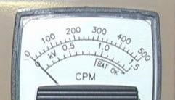
Example Scale for Rate Meter Simulation

